Slide 1
Face Mask Detection And Proximity Sensor
Presented by
Temitope Badekale

Slide 2
Introduction
The purpose of the project was to develop a model that will help implement covid-19 regulations like use of face mask and keeping 6ft apart in public places(mall, library )
I made use of python to build the model , the primary packaged I used in python are tensorflow and Opencv
The model was made using Deep Learning

Slide 3
Model Building
Face detection Model
Mask Detection
Model
Distance Calculation
Data Sourcing
(picture of faces with and without mask)

Slide 4
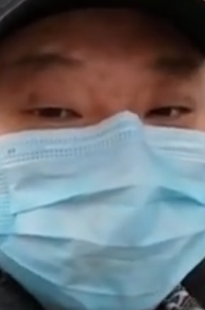
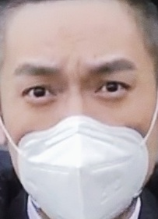
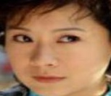
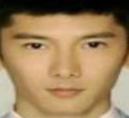
Model Building
Data Sourcing
Faces with mask
Faces without mask
1915 pictures
1918 pictures
Image Data Generation was also used on the image
Notes:
Image data generation help in change the orientation(rotation , size, proportion) of the image
so that the model will not be confused in predicting life image

Slide 5
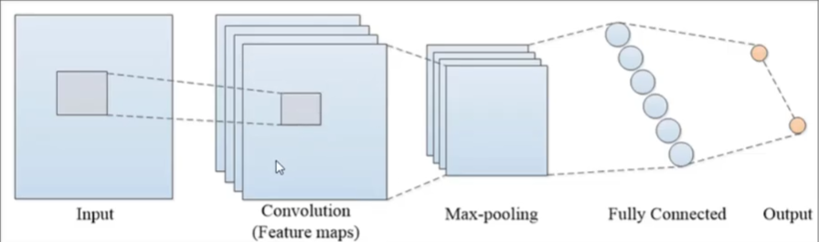
Model Building
Convolutional Neural Network
Notes:
Cnn was used because I am build a model to predict faces. Moblenet ,
Gan can also be used in image processing.
Max pooling – reducing image size

Slide 6
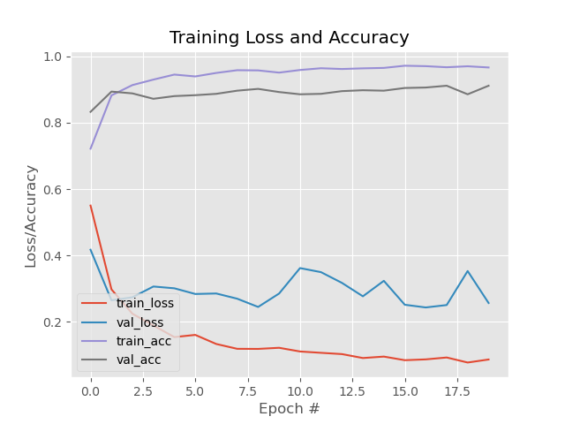
Model Evaluation
Notes:
Loss –error, accuracy was the metric I choice
Training acc– 98% Training loss – 8%
Validation acc- 90% Val loss – 28%

Slide 7
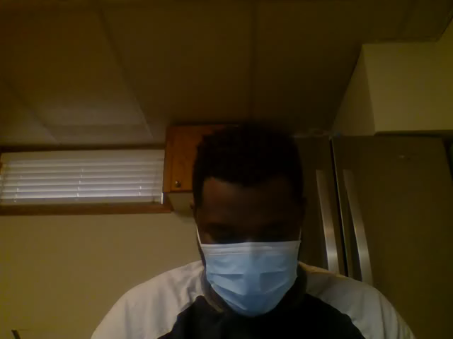
Mask Detection Model
Model detect a person face
Model detect if a person is on mask or not

Slide 8
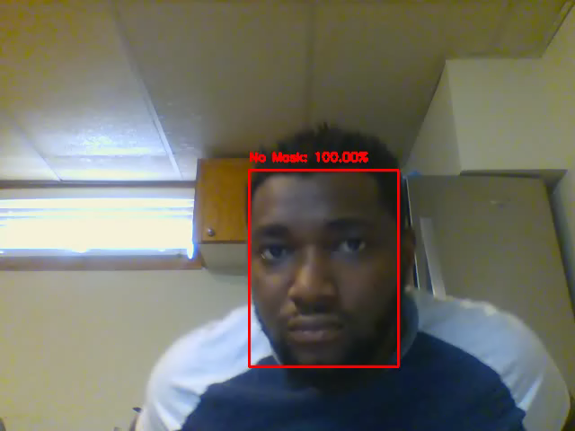
Proximity
Model calculate the distance between two or more faces
The distance line only comes up when the distance apart is less that the given threshold
Notes:
The threshold is the 6ft limit

Slide 9
Observation And Conclusion
The model performance was good in identifying face mask users
The program could be deployed as an Application programming interface(API)
The program could be use at automated entrance to allow only face mask users in
The program could be deployed at the crosswords to ensure social distancing
Notes:
The program could be deployed at the crosswords to remind people to keep there distance

Slide 10
THANK YOU
Do you have any questions?

